Slide 1
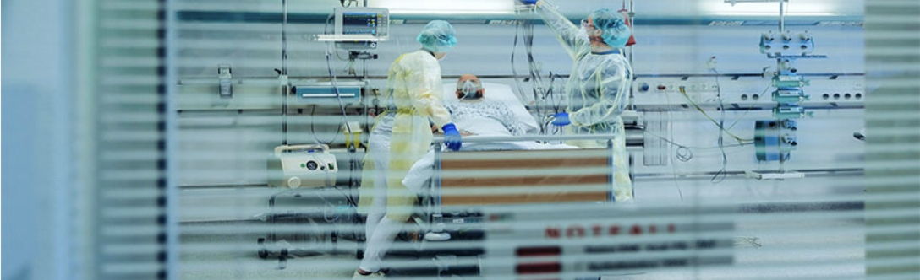
Capstone Project By Karishmaa Fernandes 20/3/2021
Using Machine Learning to predict ICU Transfer in Hospitalized COVID-19 patients.

Slide 2
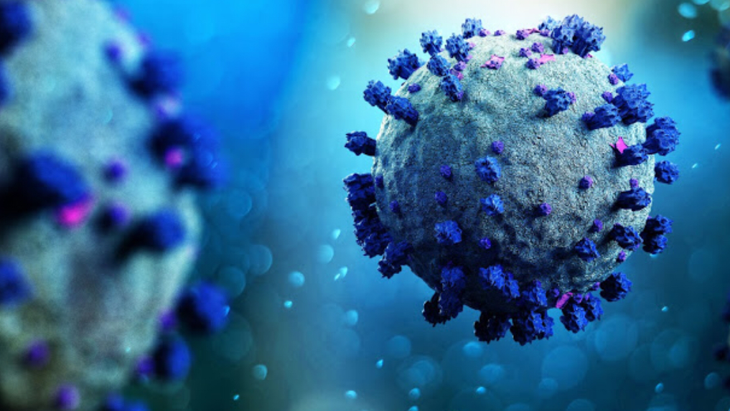
Introduction
Coronavirus disease 2019 (COVID-19) is a contagious disease caused by severe acute respiratory syndrome coronavirus 2 (SARS-CoV-2).
The first case was identified in Wuhan, China, in December 2019.
The disease has since spread worldwide, leading to an ongoing pandemic.
Common signs of infection include:
Respiratory symptoms
Fever
Cough
Shortness of breath and breathing difficulties
In more severe cases, infection can cause pneumonia, severe acute respiratory syndrome, renal failure and even death.
Intensive care units (ICUs) are key to improving the survival of patients with severe COVID-19, providing oxygen, 24- hour monitoring and care and assisted ventilation when needed. Therefore , ICU beds are a precious resource in locations where COVID-19 case numbers are high.
Therefore, provisioning ICU resources for infected patients require rapid decision-making processes, both to utilise resources efficiently and reduce patient suffering and mortality.

Slide 3
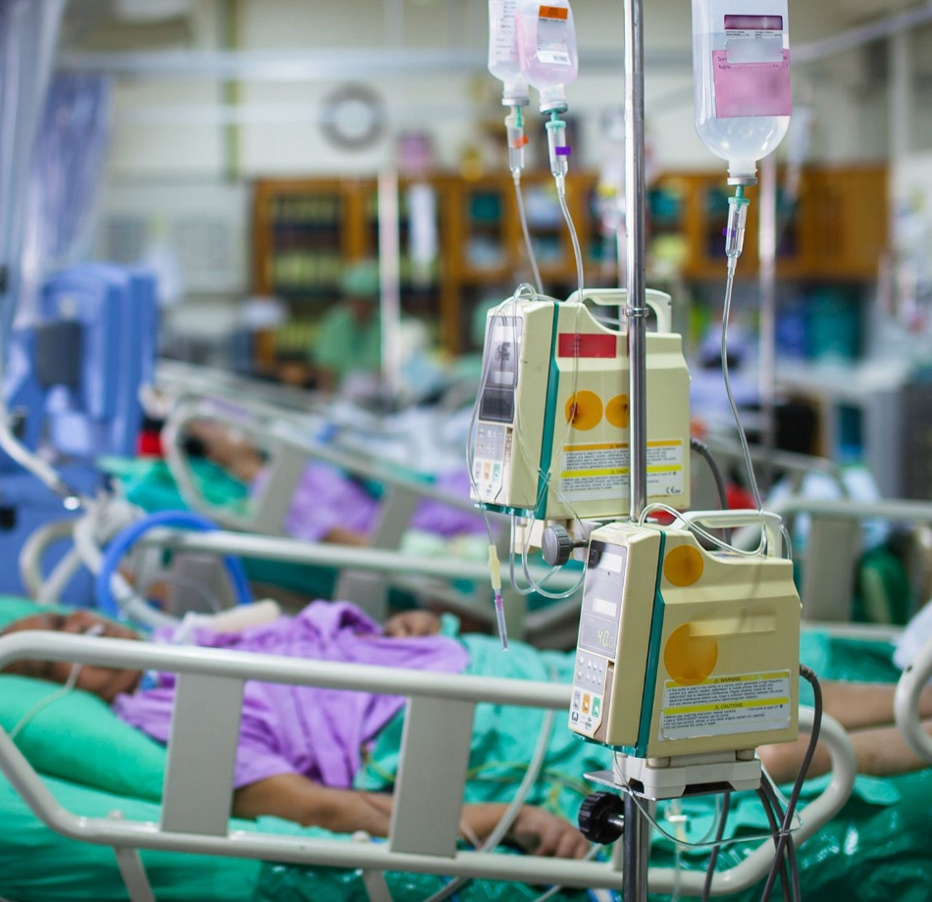
Hypothesis
If a patient exhibiting symptoms associated with COVID-19 enters a hospital and given the age, gender , past history of comorbidities and other vital signs for that patient , then I can predict using a trained supervised machine learning algorithm if that patient will need an Intensive care unit (ICU ) transfer.
This is a binary classification challenge. My goal will be to predict the patient was admitted to the ICU is 0 or 1.
If ‘ 1’, patient was admitted to ICU.
If ‘0’ patient was not admitted to ICU.
The aim is to provide hospitals with the most accurate answer, so ICU resources can be arranged or patient transfer can be scheduled.

Slide 4
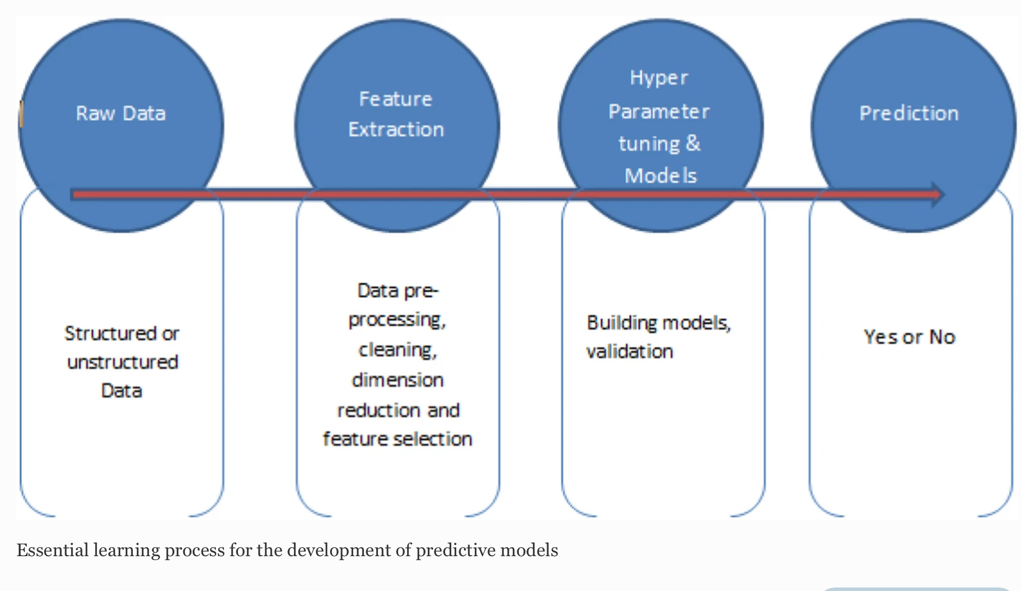
Methodology
The flow of the project is as follows:
1.Data Collection
2.Data Cleaning and Pre-processing
3. Analysis and Visualization
4.Training and Testing models
5. Result Analysis

Slide 5
Methodology
For this project I will analyse and compare the performance of four different supervised machine learning algorithms for classification:
1.Support Vector Machines( SVM)
2.Random Forest( RF)
3.K-Nearest Neighbour(K-NN)
4.Decision trees
I have chosen these algorithms because of their superior performance and fast execution.
Model features included patient demographic information , Past Comorbidities, Blood results , and Vital signs.
The output or target variable is ICU.
The dataset was randomly split (70:30) into training and test sets. The models were trained on the training set and its predictive performance on the test set was then evaluated.
The best level of accuracy between these four algorithms will be determined by comparison of metrics for assessing predictive performance such as accuracy, precision and recall.
Result- Can we predict which inpatient will need intensive care unit( ICU)-Yes/no?

Slide 6
Methodology
Brief description of the Supervised machine learning algorithms used for classification:
1.Support Vector Machines( SVM)- We find a hyperplane that discriminates between two classes by maximising the margin between the classes. The instances that are the closest to the hyperplane are called support vectors. In this project I have used SVM with a linear kernel.
2.Random Forest( RF) method constructs each tree from a bootstrap sample drawn with replacement from the original dataset. In this project , I have used criterion as Gini, maximum depth=6 and random state=23.
3.K-Nearest Neighbour(K-NN) is a non-parametric, lazy learning algorithm. It classifies new cases based on a similarity measure (i.e., distance functions).In this project, I have used K=14.
4.Decision trees classify the examples by sorting them down the tree from the root to some leaf/terminal node, with the leaf/terminal node providing the classification of the example. Each node in the tree acts as a test case for some attribute, and each edge descending from the node corresponds to the possible answers to the test case. This process is recursive in nature and is repeated for every subtree rooted at the new node. In this project , I have used criterion as entropy, maximum depth=4 and maximum leaf nodes=10.

Slide 7
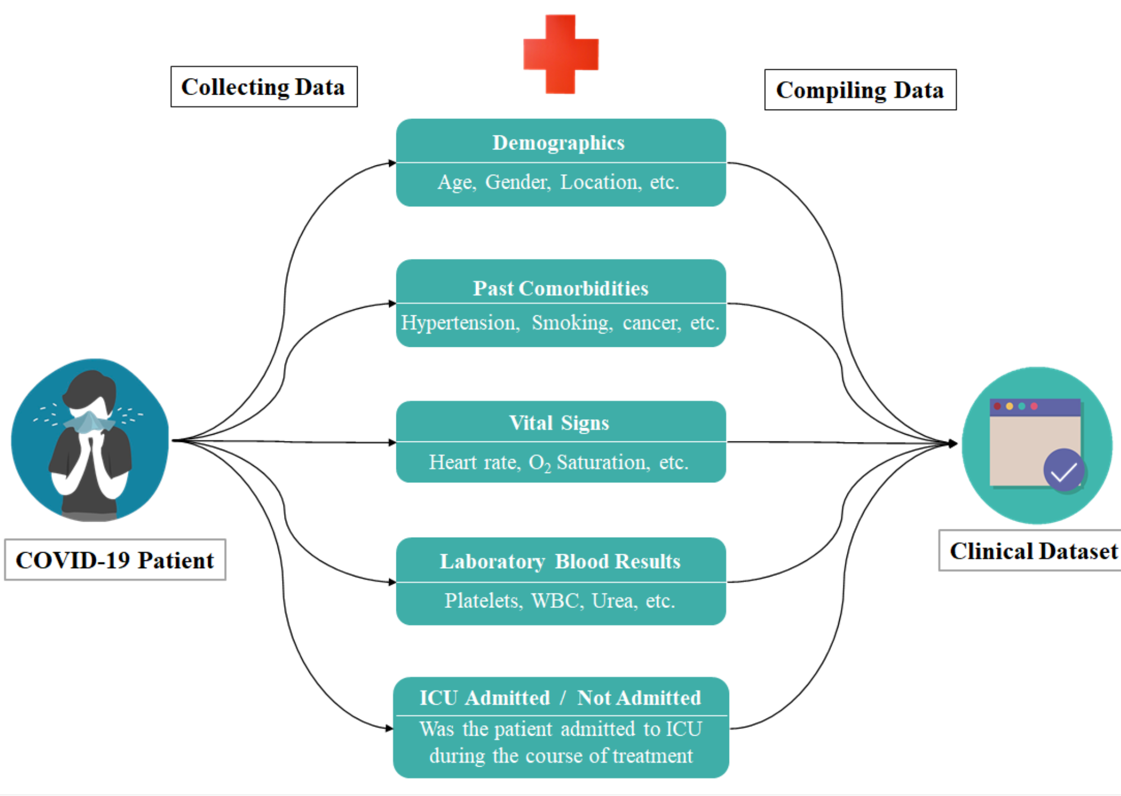
Dataset Description
The dataset contains anonymized data from Hospital Sírio-Libanês, São Paulo and Brasilia.
https://www.kaggle.com/S%C3%ADrio-Libanes/covid19.
This a high dimension dataset with 1925 rows and 231 columns.
Data contains clinical details of patients in time-window format. There are 5 windows for each patient i.e. 0-2, 2-4, 4-6, 6-12, 12+ hours according to the admission in hospital.
The dataset is divided into the following categories:
1.Patient demographic information: Age above 65, Gender
and Age Percentile .
2.Past Comorbidities: Anonymized Disease Groupings1-6,
Hypertension, Immunosuppressed, 6 other confidential
groupings.
3.Blood results: Albumin, Calcium, Glucose, Haemoglobin,
Sodium, Urea, Platelets, etc
4.Vital signs: Blood Pressure, Heart rate, Respiratory rate,
Temperature, Oxygen saturation.

Slide 8
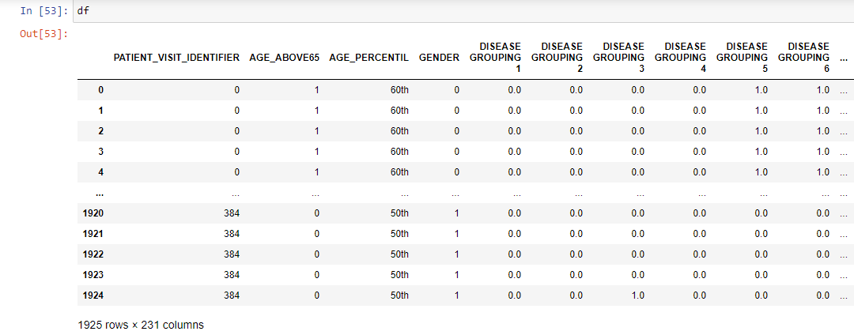
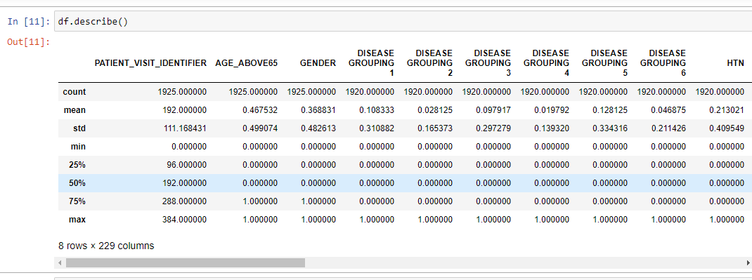
Data Cleaning and Pre-processing
This dataset has 1925 rows and 231 columns.
Data was read in pandas data frame in excel.
There are 54 features in the dataset.
The Dataset is cleaned and scaled by column according to Min Max Scaler to fit between -1 and 1,so we didn't have to scale or normalize the data.
A few columns had missing values, which have been imputed using the mean of values of all windows of the patient.
Time Window and Age Percentile columns were of type string, so I performed One Hot Encoding on them ,so I can use the machine learning algorithms.
The figures show:
1. the dataset
2. the Statistical summary of the dataset.

Slide 9
Data Analysis and Visualization
Data was analysed on these categories of attributes:
Demographics,
previous Grouped Diseases (Comorbidities)
Blood Test Results
Vital signs
Patient event Window and ICU Admission Count
I used Seaborn for plotting and visualization of the dataset.
Plots like bar graphs, count plots, heatmaps etc. were used to understand the given data.

Slide 10
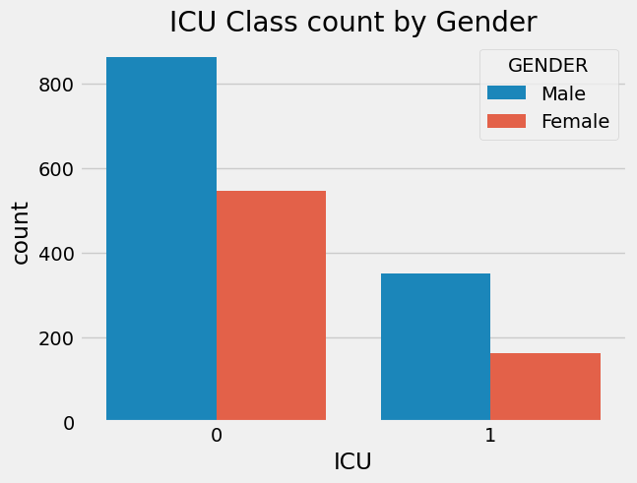
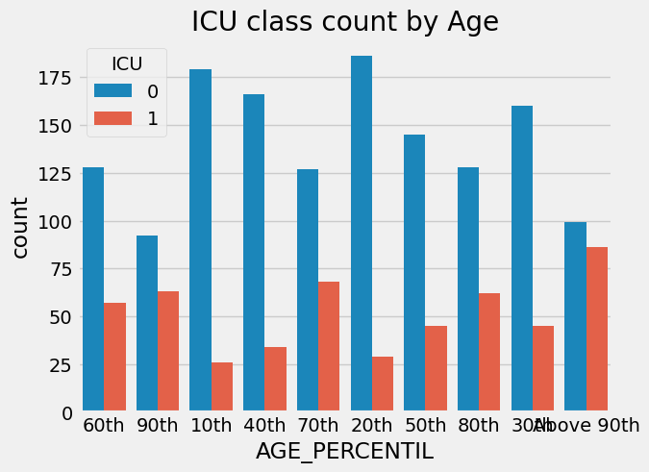
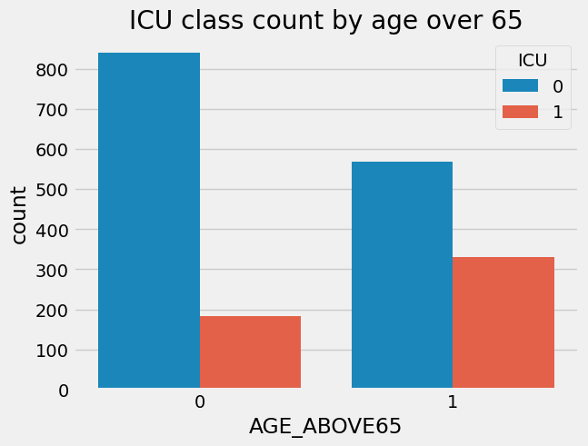
Visualizations
1.Demographics
After analysing the demographics of data:
I found that patients above the age of 65 are more likely to be admitted in the ICU than people with lower ages.
There are more males in the ICU then females.

Slide 11
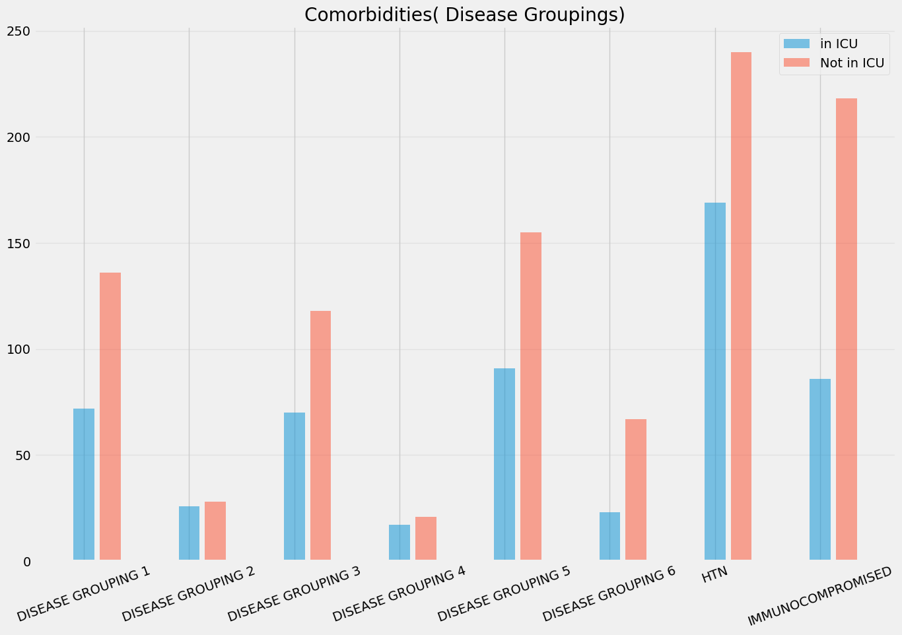
Visualizations
2.Past Comorbidities:
The labels for the past comorbidities were anonymized by the dataset author to respect the privacy of patients.
Disease groupings 1,3,5 as well as patients with hypertension and who are Immunocompromised are more likely to be in ICU.

Slide 12
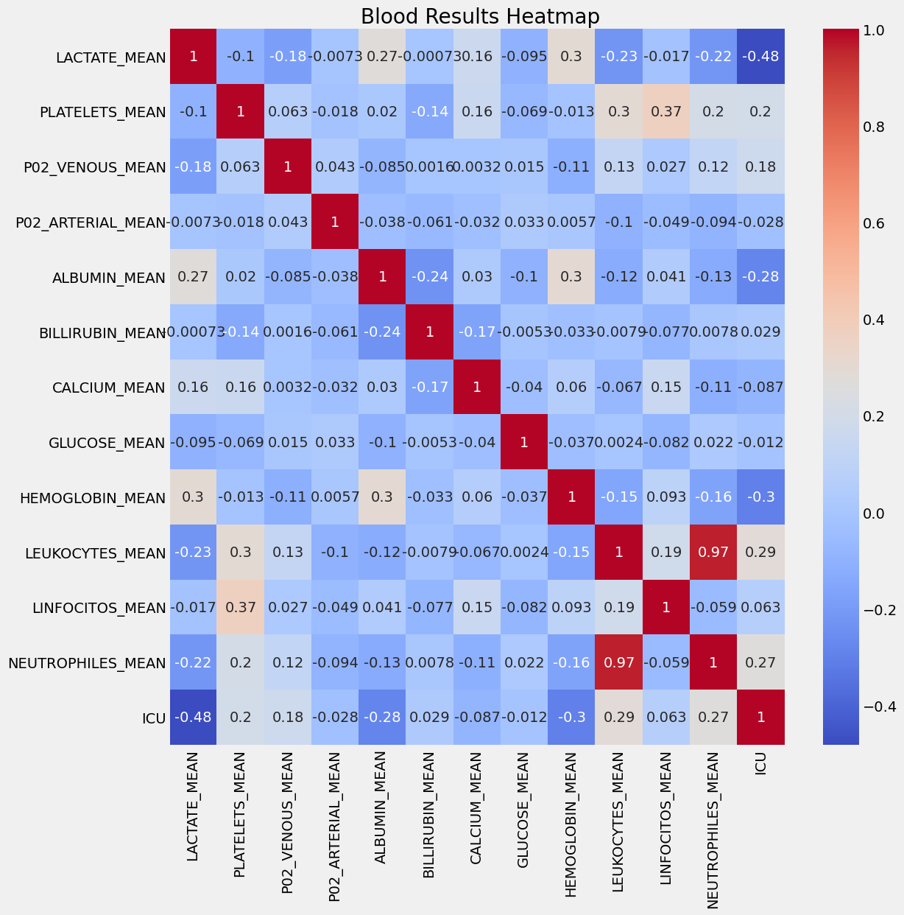
Visualizations
3.Blood Results:
Now , for vital signs and Laboratory results there were a large number of features, so I used a correlation matrix for feature selection and visualized it through heatmap.
I noticed that features having a high correlation with the target label i.e. ICU admissions are important and can be used for prediction.
I analysed the laboratory results in both ICU admitted and not Admitted patients and found that platelets ,Leukocytes, Neutrophils are some of the major indicators where I saw a significant difference.
I haven’t included all the attributes for the purpose of simpler visualization.

Slide 13
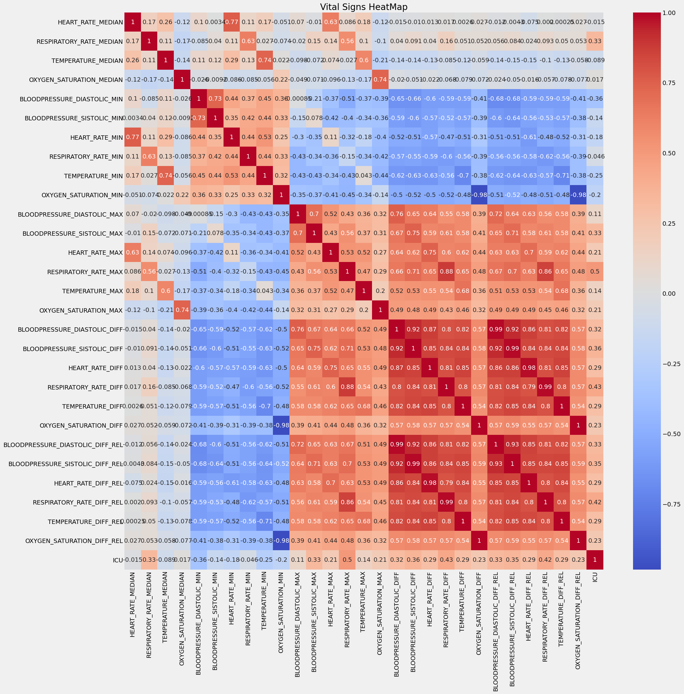
Visualizations
4.Vital Signs :
The vital clinical characteristics of a patient are the ones that can be monitored live.
These signs are generally used to know about the present health condition of the patient.
Top vital sign predictors were Blood pressure, Temperature, Oxygen Saturation , heart rate and Respiratory rate are significant indicators.

Slide 14
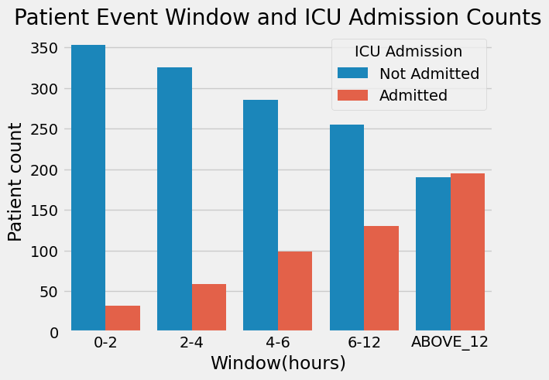
Visualizations
5.Patient event Window and ICU Admission Count:
There is a clear positive correlation between the Window and ICU Admission.

Slide 15
Organisational challenges
Low sample size and class imbalance resulting from low ICU transfer.
Since the model is based on data from a single hospital , its case mix may not be easily generalizable to other settings.
Also we see large variability in how different patients with COVID-19 do, even among close relatives with similar environments and genetic risks.
Limited Number of Advanced Medical Resources like ICUs.
Uneven requirement and load on ICU’s across hospitals.
What can help us overcome these challenges?
We need more data to improve our algorithm performance.
This type of predictive analysis should be carried out on data from other parts of the world to improve performance of the algorithm.
A strategy that can assess and analyse the clinical data of confirmed COVID-19 patients.
A model that can accurately predict the need of ICU on the basis of clinical data.
Predicting as soon as the patient is admitted to hospital. The earlier the better.
Planning flow of operations on the basis of prediction.

Slide 16
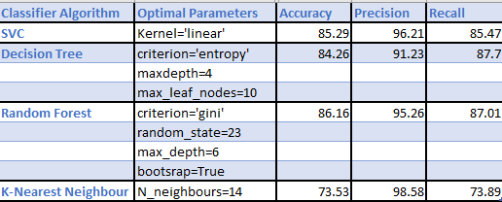
Results
Results of all models with their optimal parameters are provided in the table:
The models were evaluated using an accuracy, Precision , Recall performance evaluation metrics to determine their efficiency and quality.
All the algorithms performed well, but I found that the best performance was achieved by Random Forest. The accuracy obtained was 86.16 % with a precision=95.26% and Recall=87.01%
I used criterion as gini, random_state =23,maximum depth as 6,bootstsrap=True.

Slide 17
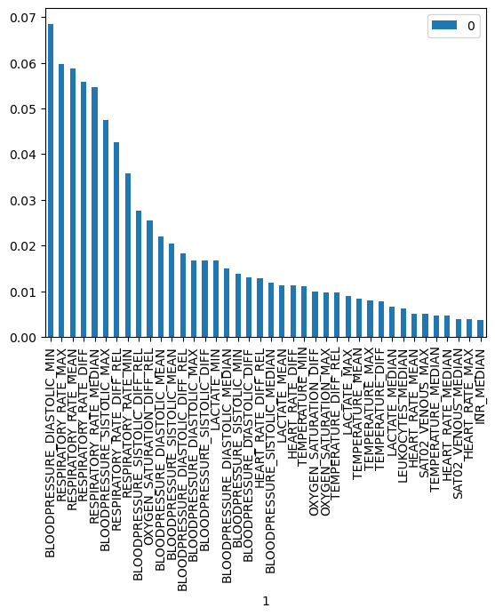
Results
Random Forest Feature Importance:
Feature importance refers to a class of techniques for assigning scores to input features to a predictive model that indicates the relative importance of each feature when making a prediction.
Fig below shows that Blood Pressure , Respiratory Rate and Oxygen Saturation are the most important features in predicting if a patient will need ICU transfer.

Slide 18
Conclusion
My analysis show that out of the four classification models, Random Forest predicts ICU Transfer in Hospitalized COVID-19 Patients with the highest accuracy.
The project also demonstrates that, patients with underlying comorbidities and aging patients are more likely to need ICU transfer.
Finally from all the analysis ,I agree with my hypothesis that it is possible to predict ICU transfer in confirmed COVID-19 patients using Random Forest model, given their age, gender , past history of comorbidities and other vital signs.
Early detection of COVID-19 patients is essential for identification of vulnerable patients who may need special care to survive the disease, optimal usage of resources as well as estimation of number of beds required in intensive care units.
This shows the important roles playing by supervised ML algorithms in prediction, diagnosis and containment of the COVID-19 pandemic, which can help reduce the huge burden on limited healthcare systems in most of the nations around the world, especially developing nations.

Slide 19
Follow - up Questions
Further studies are needed to:
1.Validate the algorithm on a large number of patients across additional healthcare systems.
2.a crossing of data is proposed to improve the analysis considering other variables, i.e. social-economic data, previous existence of health issues related to patients, considering data of other hospital .
3.Integrate the complexity of the model within clinical workflow.
4.Assess if clinical features identified by the algorithm may provide targets for medical intervention to alter the clinical course.

Slide 20
GitHub Link of the Jupyter Notebook
https://github.com/KarishmaFernandes/Predicting-ICU-Transfer-in-hospitalized-COVID-19-patients/blob/main/Kaggle_Sirio_Libanes_ICU_Prediction.ipynb

Slide 21
References:
1.https://www.kaggle.com/S%C3%ADrio-Libanes/covid19
2.https://en.wikipedia.org/wiki/COVID-19_pandemic
3.https://scikit-learn.org/stable/
4.https://labblog.uofmhealth.org/rounds/using-machine-learning-to-predict-which-covid-19-patients-will-get-worse
5.https://www.mdpi.com/2077-0383/9/6/1668

Slide 22
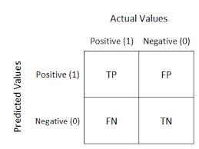
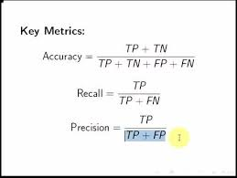
Appendix
Evaluation Metrics
Confusion matrix is a table that is often used to describe the performance of a classification model on a set of test data for which the true values are known. It is a table with four different combinations of predicted and actual values in the case for a binary classifier.
Accuracy measures the fraction of correct predictions made. It is the ratio of the number of correct predictions over the total number of predictions.
Precision measures a classifier’s ability to not falsely label a positive document as negative. It is the ratio of true positives over all positive predictions.
Recall is the measure of the success in retrieving all positive samples. It is the ratio of the number of correct predictions made over the total number of positively labelled documents .

Slide 23
Thank You!

